Slide 1

Program Analyser for “Static Analysis of Posterior Inference in Bayesian Probabilistic Programming”
Guanyan Li

Slide 2

Purpose
Analyse the user program and generate the required information for the program solver (written by Peixin) to solve the problem.
Generate:
Truncation information
Generate guards according to the next location of every execution path

Slide 3
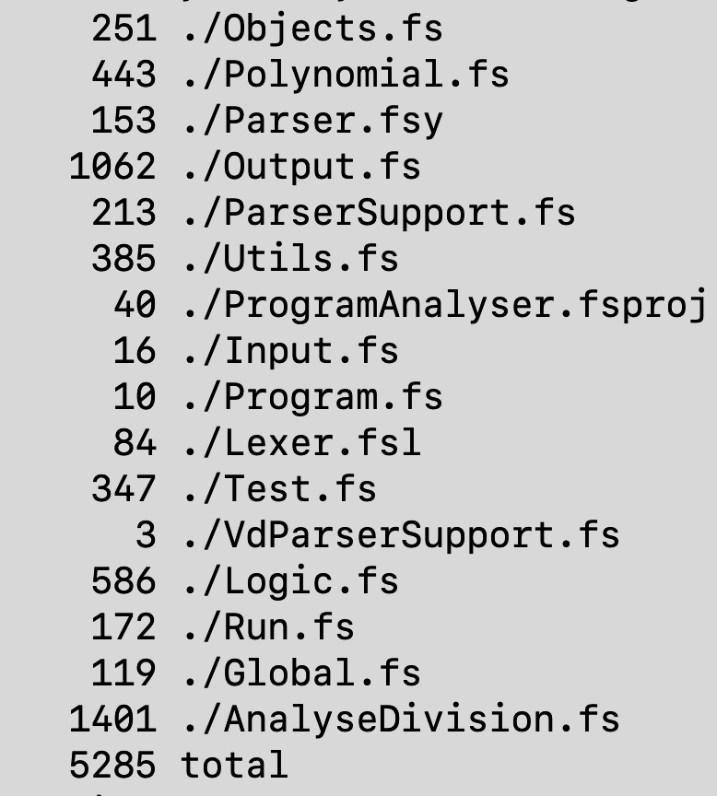
Analyser Features
Parse input program files
Analyse and aggregate the loop execution paths
SMT-Based execution analysis
Heavy local logical analysis (Solver does not support related concepts)
Heavy local arithmetic support to extract customised information
Generate program information for problem solver

Slide 4
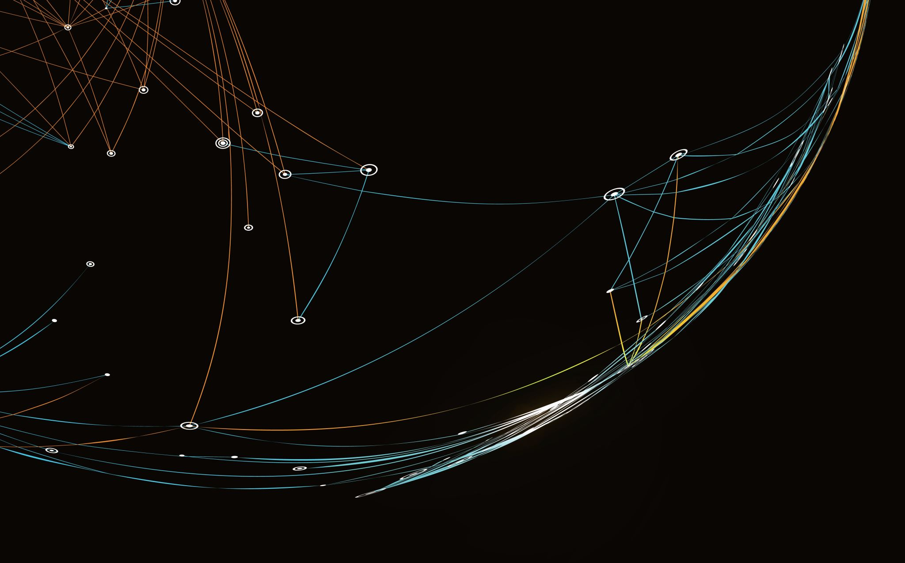
IO-Specs
Input & Ouput

Slide 5
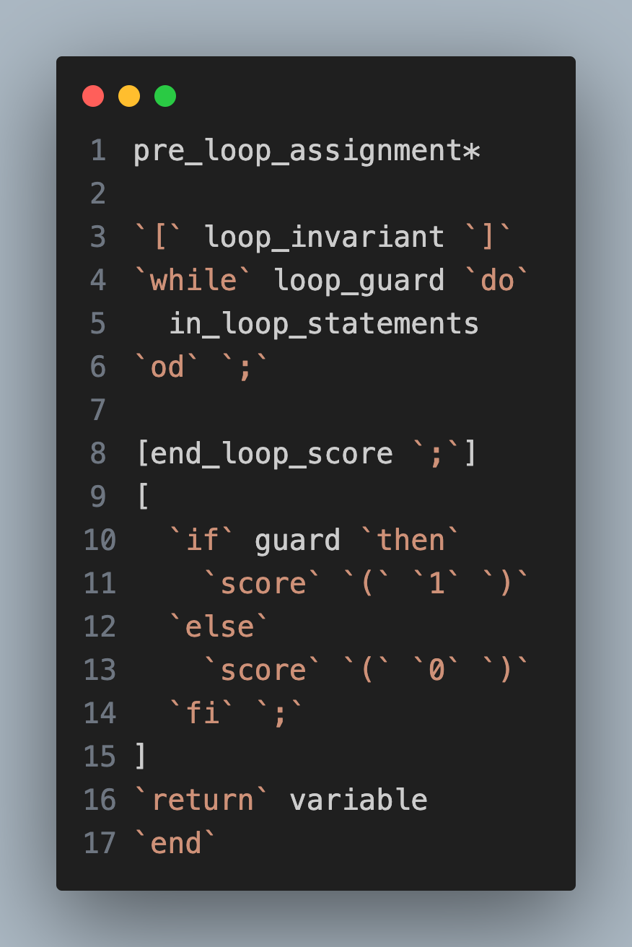
Input File Format
A restricted input format that admits only a single non-nesting looping.
There is a special end loop score that qualifies whether the result is of weight 0 (for better optimisation).

Slide 6

Output Model: 3-Location Model
An output file refers at most to 3 locations.
Abbreviating the locations based on the restriction of input programs.
Speeding up the polynomial synthesis by minimising possible locations.
Loc 1: the looping location
Loc (-1) / (-10): the ending location with non-0 scoring at the end.
Loc (-1): ending with non-constant-1 score.
Loc (-10): ending with constant-1 score.
Loc 0: the ending location with 0 scoring at the end.

Slide 7
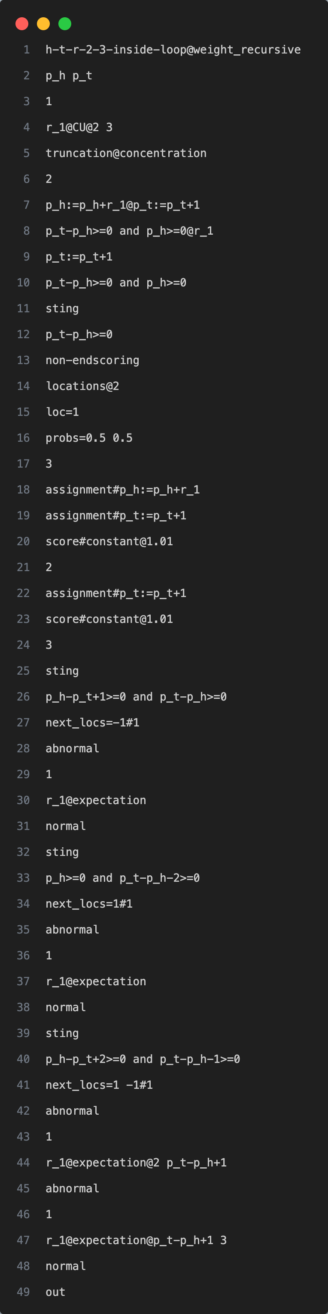
Output Format

Slide 8
Output Format
Program Name

Slide 9
Output Format
Program Scoring Type: score-recursive or not

Slide 10
Output Format
Program variables
Number of random vars
Rand var(s) information

Slide 11
Output Format
To truncate or not

Slide 12
Output Format
Termination type

Slide 13
Output Format
Paths information for truncation

Slide 14
Output Format
Truncation Guard

Slide 15
Output Format
Loop Guard

Slide 16
Output Format
End loop scoring information, which is none here

Slide 17
Output Format
Paths Relation
Path Information for each execution path within the loop

Slide 18
Output Format: Paths Guard Division
Divide each path according to their behaviour.
With more fine-grained analysis of the paths, Peixin may extend the feasible range of the synthesised polynomial(s).

Slide 19
Output Format: Paths Guard Division
The number of division

Slide 20
Output Format: A Single Location Division
A division that does not depend on actual value of random variable(s)

Slide 21
Output Format: A Single Location Division
Division start
Division guard
Next location(s) for each path
Path 1 Mode: having random variable(s)
Random variable amount
Random variable declaration(s)
Path 2 Mode: NO random variable

Slide 22
Output Format: A Single Location Division
Another single location division

Slide 23

Output Format: A Multi-Location Division
Random variable $r_{1}$’s range to get to location 1.
Random variable $r_{1}$’s range to get to loction -1.

Slide 24

Implementations
Analysis & Division

Slide 25
Algorithm Overview
Flattening and enumerating the paths from the control flow.
Flattening: merge multiple branches to a single one, computing the total path condition and also the total probability.
However, one must take care of the actual branching type and point – the interleaving points between paths must be kept.
For each path, divide the possible execution paths according to its next location and combinations.
Combine the division information for each path together – two division can be merged, iff their guards are compatible.

Slide 26
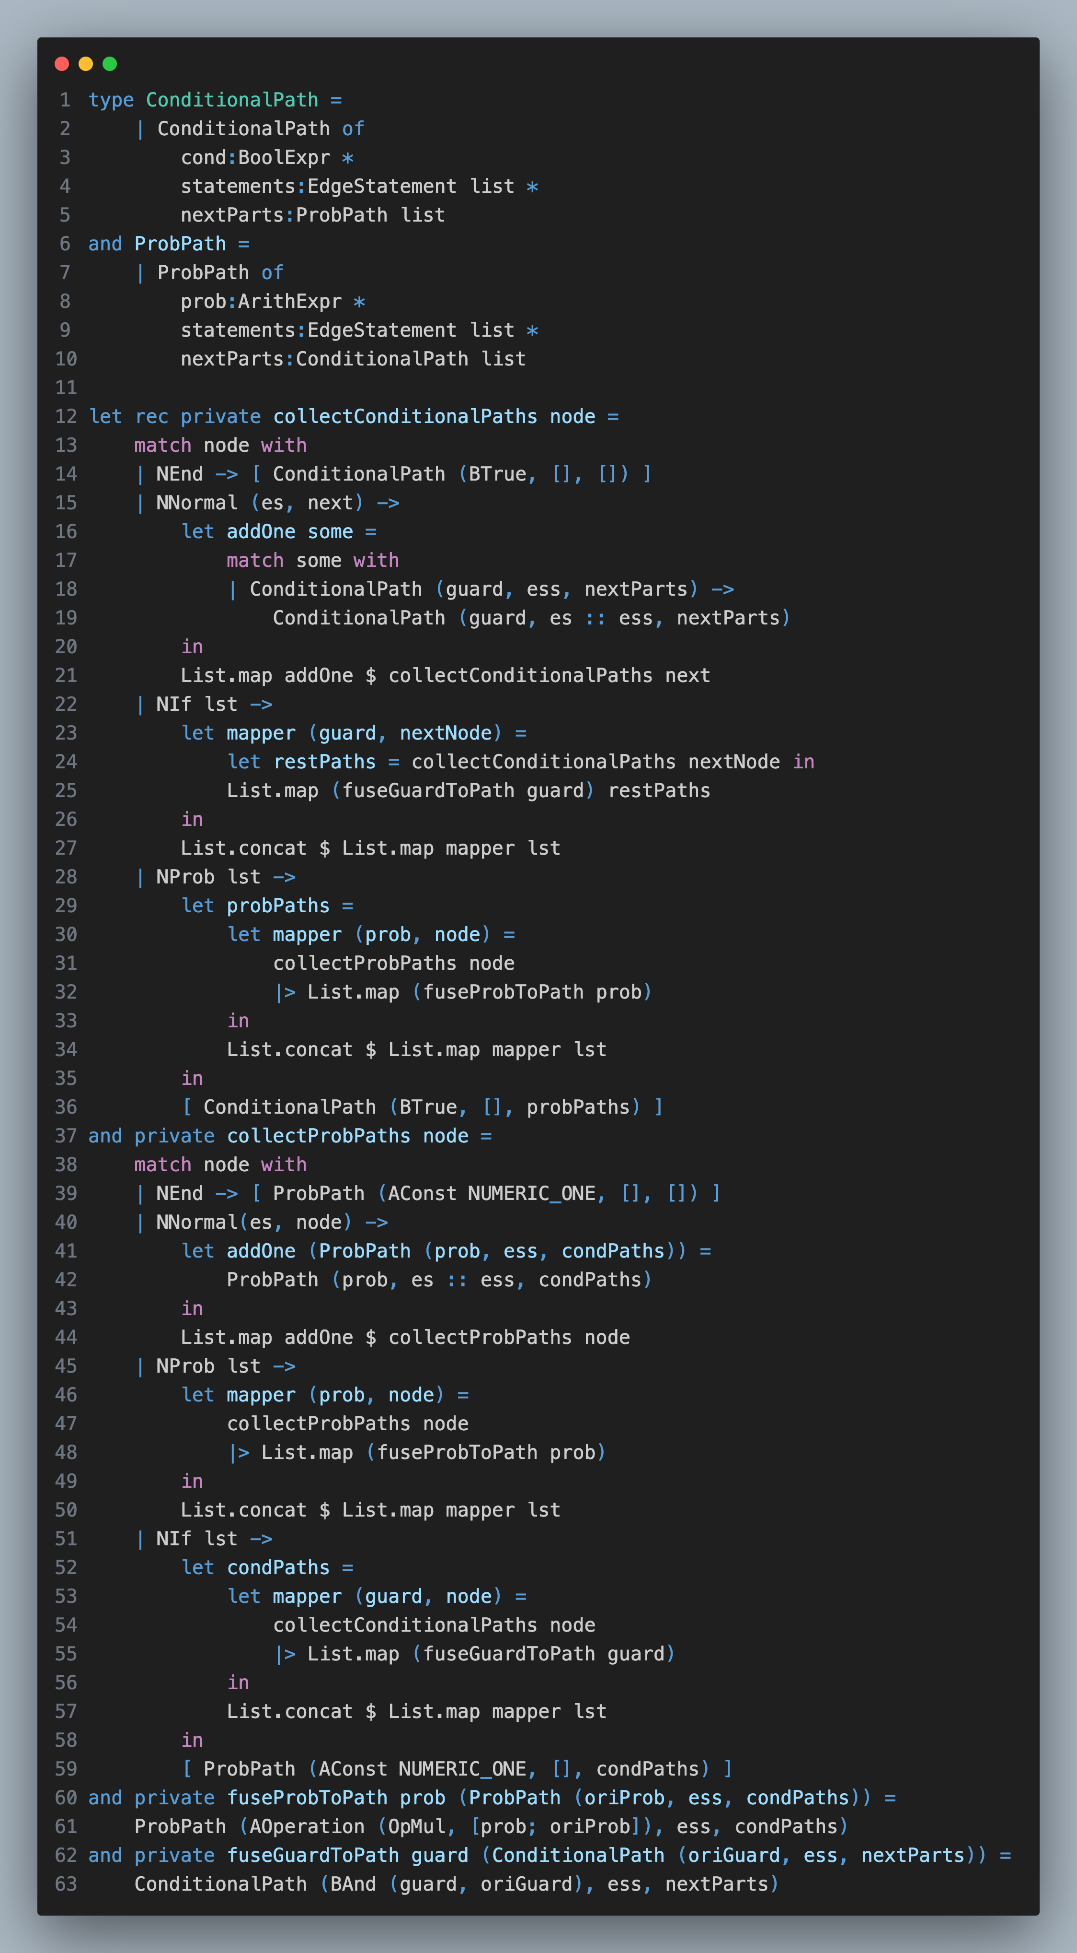

Flattening: CFG $⇒$ Multi-Hyper-Edges
Analyse the control-flow graph, enumerate the paths by converting them to multi-hyper-edges.
Recursively, save the path condition or probabilities while preventing interleaving.
Probabilistic branches should be combined finally.
Conditional branches are not allowed to combine.
Conditions are propagated globally forward to form the actual path condition*.
Probabilities are propagated locally.
* Generally, the path condition should be computed via weakest-precondition
We here assume that no further qualifying is applied to updated variables in one iteration.

Slide 27
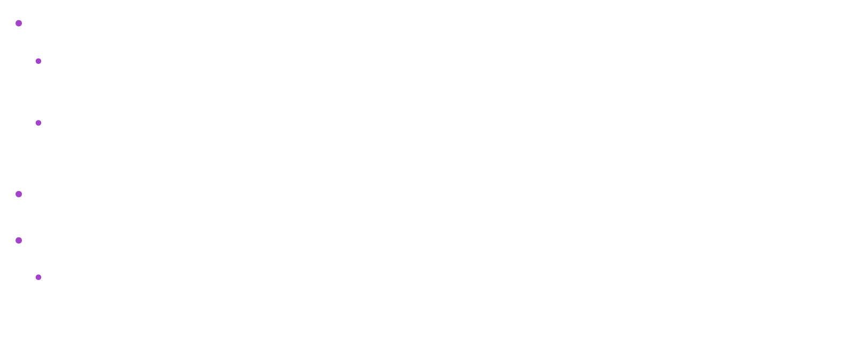
Valuation Division: Various Basic Guards
The fixed guard $g_{f}$.
This guard denotes the fixed part of the path that according to the context, this path must satisfy the condition.
The conjunction of: loop guard, loop invariant as well as the path condition for conditional paths.
The loop guard $g_{ℓ}$.
The after loop non-0 score guard $g_{s}$.
Which is by default $True$ if not specified.

Slide 28
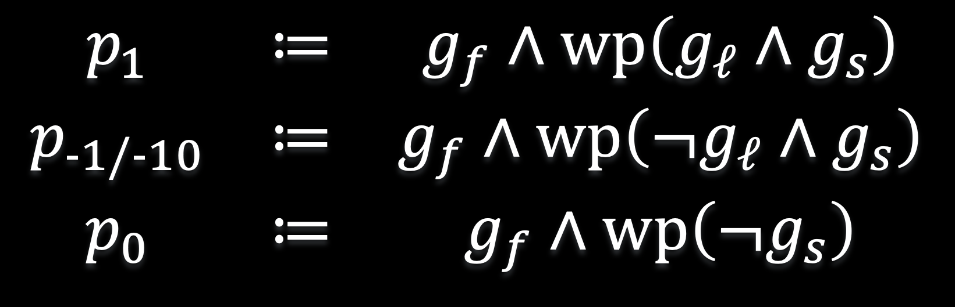
Valuation Division: Location Conditions
The condition the path should satisfy before execution to reach the target location.
$$\begin{matrix}p_{1} & ≔ & g_{f}∧wp\left(g_{ℓ}∧g_{s}\right) \\ p_{−1/−10} & ≔ & g_{f}∧wp\left(¬g_{ℓ}∧g_{s}\right) \\ p_{0} & ≔ & g_{f}∧wp\left(¬g_{s}\right)\end{matrix}$$
> Here, we assume the in-loop statements are monotonically towards violating the condition.

Slide 29
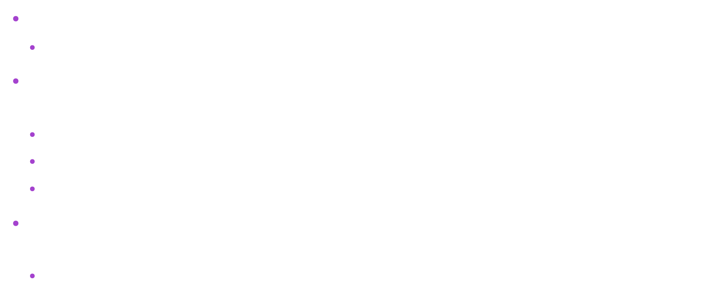
Guards
The conditions in the output must be: $e_{1}≥0∧e_{2}≥0∧…∧e_{n}≥0$.
This is called a Guard.
Hence, any proposition should be divided into mutually exclusive DNF form.
Hence a guard is a SAT clause within the DNF.
This is not supported by the Z3 solver and is hardly supported by others.
Hence, this is implemented locally within the program.
Also, guards should be merged, hence reducing the number of guards that are the same.
For example, $1<t<2∨t=1$ can be merged to $1≤t<2$.

Slide 30
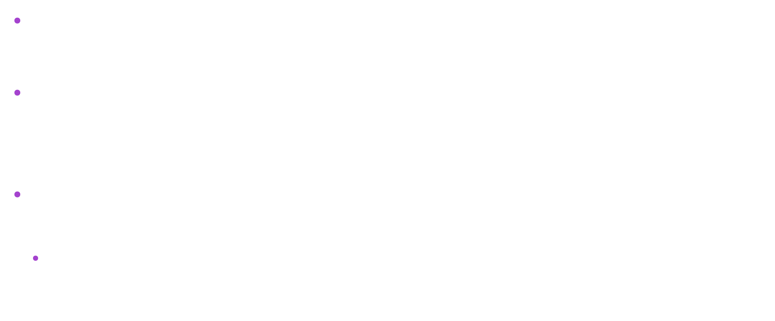
Single-Location Guard(s): Quantifier Elimination
According to the paper, every random variable has a fixed ranged picked.
Given a single location condition $p_{i}$, the single-location guard $g_{i}^{⋄}$ such that: for all random variables in the fixed (interested) ranged, the equivalent condition that $p_{i}$ holds.
This is essentially a problem of Quantifier Elimination that:
$$g_{i}^{⋄}≔QE\left(∀\tilde{r}.Range\left(\tilde{r}\right)→p_{i}\right)$$
Where $\tilde{r}$ and $Range\left(−\right)$ denotes the random variables involved and their ranges.

Slide 31
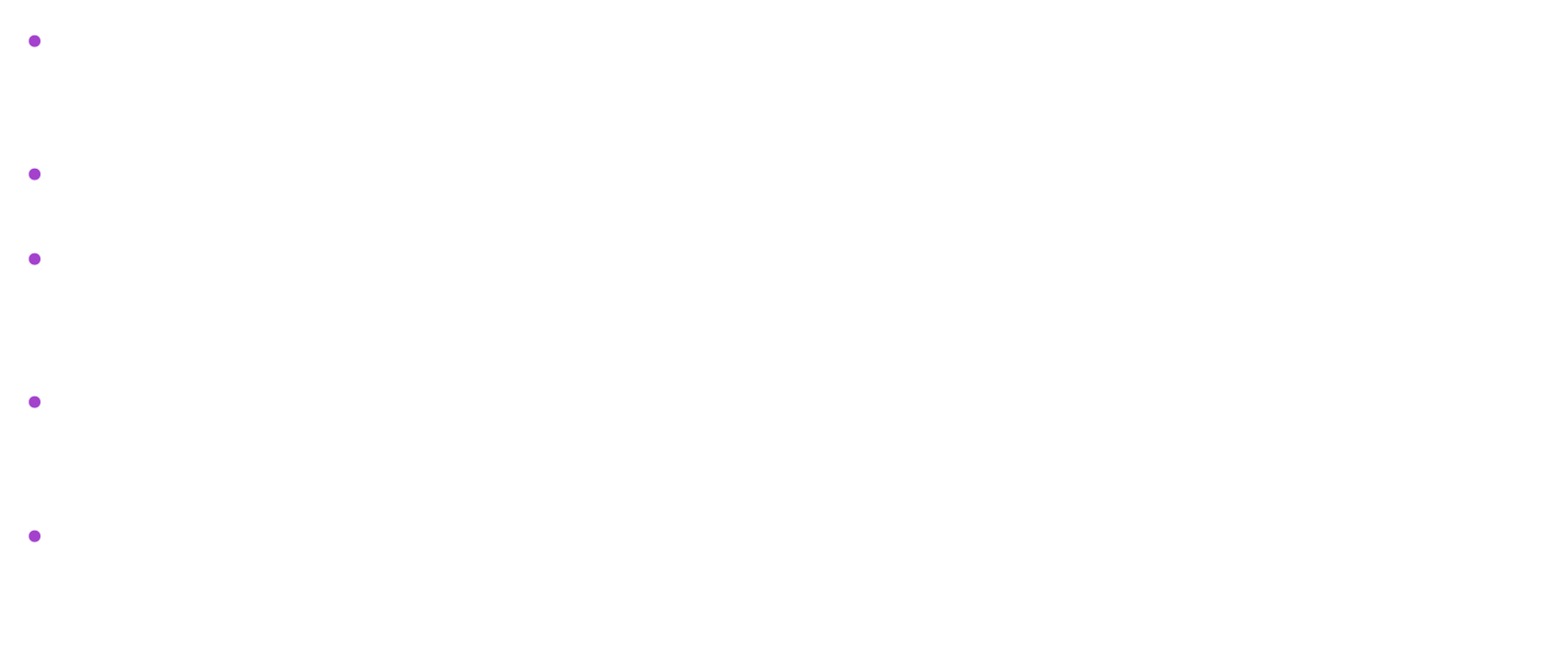
Join-Location Guard(s): What Does It Mean?
Then, we will need to consider the join guards when multiple locations are possible and is depending on the value of the random variables.
Hence, the join location guards are (Clauses of): $¬g_{1}^{⋄}∧¬g_{−1/−10}^{⋄}∧¬g_{0}^{⋄}$.
On the other hand, note that: $p_{1}, p_{−1/−10}, p_{0}$ form a partition of all value, that $p_{i}∧p_{j}=False$ while $p_{1}∨p_{−1/−10}∨p_{0}=True$.
So, any join guard is also partitioned by the three, while satisfying the guard, there must exist points in different ranges.
And the key is that: the actual relation between the random variables and the other variables determine where the point is belonging to.

Slide 32
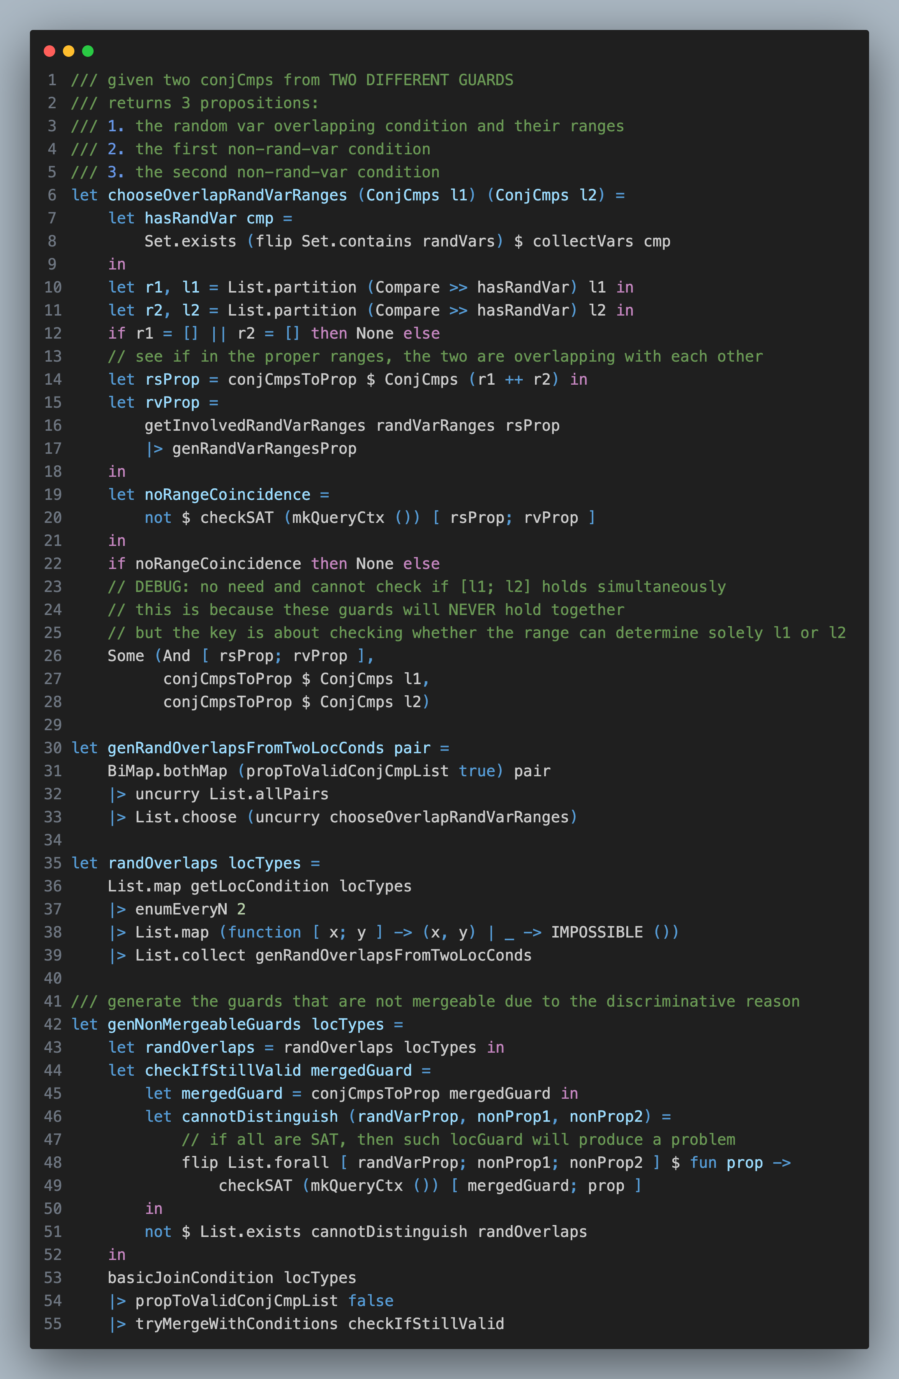
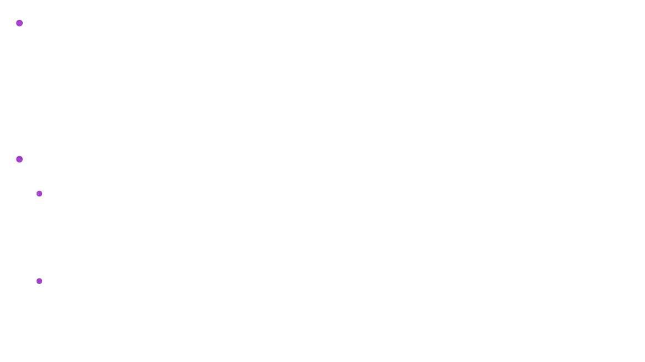
Join-Location Guard(s): Solely Depending on Rand Vars?
A point to cope with is that, in each join guard, whether a point is within one given location depends on the propositions related to the random variables in the clause.
Hence, one should make sure that:
For every $i≠j$, for every guard $g_{i}∈p_{i}$ and $g_{j}∈p_{j}$, such that the range of the random variables coincide (erasing the parts unrelated to the random variables).
Every join guard $g$ must have that: $g$ either does not contain the range of coincidence, or cannot be SAT with both $g_{i}$ and $g_{j}$ RESPECTIVELY*.
* Note that $g_{i}∧g_{j}$ must be $False$. And what one needs is that $¬\left(SAT\left(g∧g_{i}\right)∧SAT\left(g∧g_{j}\right)\right)$.

Slide 33
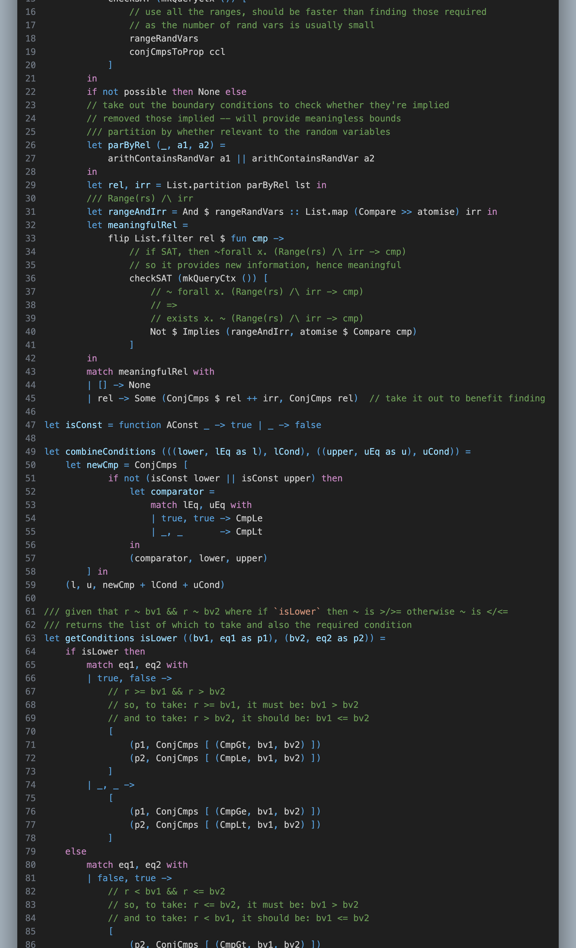
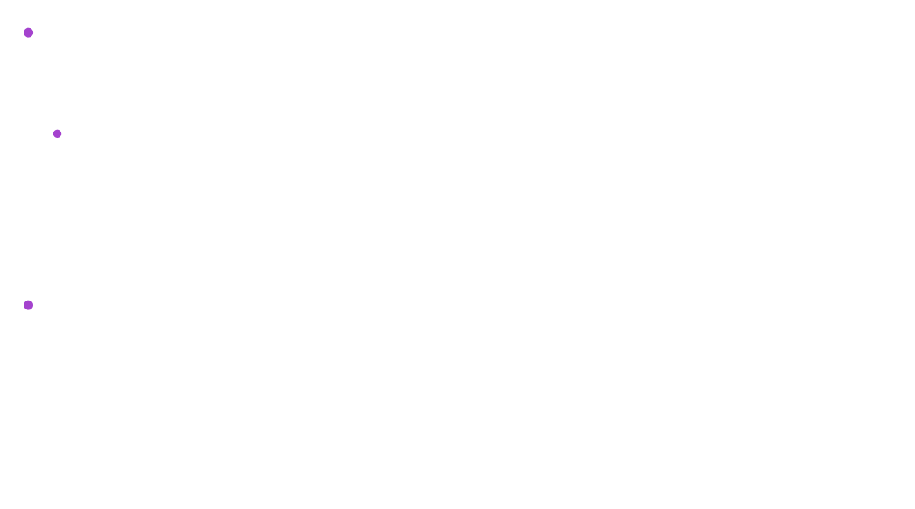
Join-Location Guard(s): Multiple Rand Var Bounds?
There is possibility when there are multiple symbolic bounds for a given random variable.
For example (Random-Box-Walk):
$$r_{1}≤10−t∧r_{1}<0.8+x$$
Hence, one should supplement the basic guard $g$ directly from dividing the clauses of DNF of $¬g_{1}^{⋄}∧¬g_{−1/−10}^{⋄}∧¬g_{0}^{⋄}$ by the new comparison guards that $\left(g∧10−t<0.8+x\right)∨\left(g∧10−t≥0.8+x\right)$ *.

Slide 34
Thank you for listening!

